Slide 1
Healthcare Analysis by country
Project by:
Husain Radhi
Hussain Darwish

Slide 2
Problem statement
The WHO needs to know the countries which are in most need of healthcare globally. By analyzing population size, GNI per capita, and life expectancy data, this project aims to identify them. We will be using python and its libraries to process the data to communicate the findings

Slide 3
Objectives
1) Which countries have low life expectency?
2) Which countries have low GNI per capita?
3) Which countries have high population, low GNI per capita and low life expectency (the top countries needing immediate healthcare support)?
4) How can we analyze and visualize the countries which need healthcare support?

Slide 4
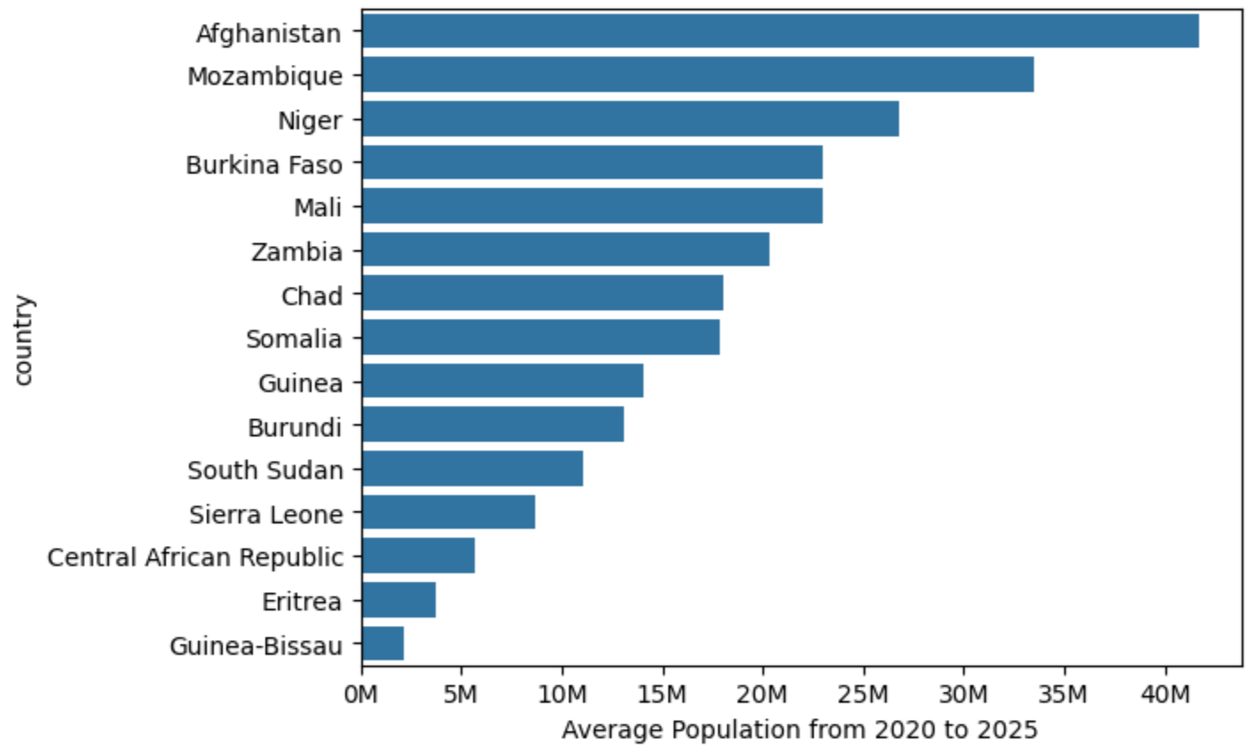
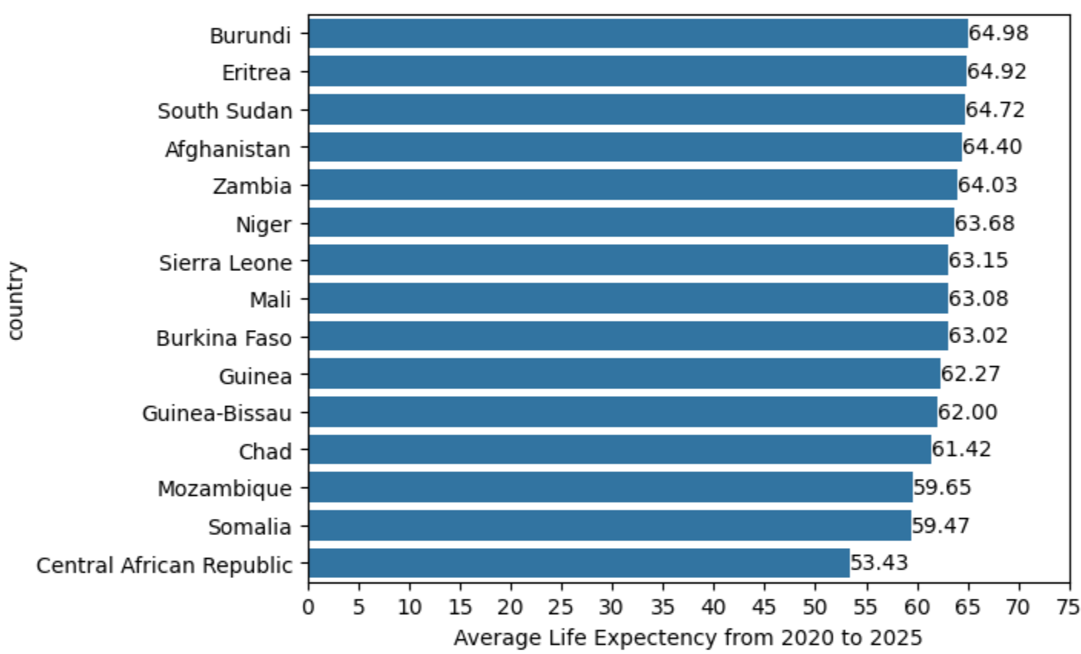
Analysis and Visuals
Average population of countries with low GNI per capita and low life expectancy
Average life expectancy of countries with low GNI per capita

Slide 5
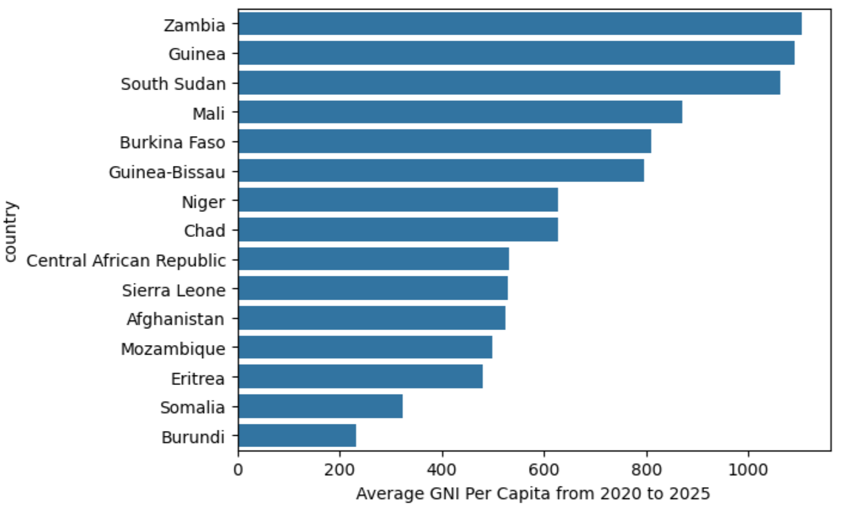
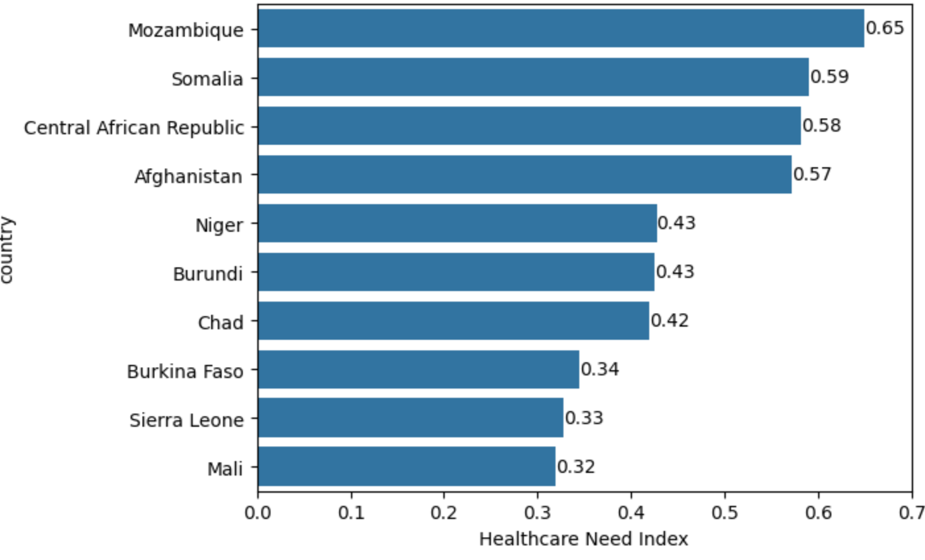
Analysis and Visuals
Average GNI per capita of countries with low life expectancy
Ranking countries based on healthcare need index. The index is based on average gni per capita, average population and average life expectancy of the past 6 years. The higher the index, the more urgent the need for healthcare.

Slide 6
Findings
Highest healthcare need index | Highest population, low gni and life expectancy | Lowest GNI and low life expectancy | Lowest life expectancy and low gni
Mozambique | Afghanistan | Burundi | Central African Republic
Somalia | Mozambique | Somalia | Somalia
Central African Republic | Niger | Eritrea | Mozambique
The top three countries with the highest healthcare need index were identified as: Mozambique (0.65), Somalia (0.59), and Central African Republic (0.58). These countries need the immediate attention of the World Health Organization

